Slide 1


Store 2022: Annual Report (Jan-Dec)
This report offers an overview of Store 2022's performance in FY22. It highlights key achievements and provides a structured view of objectives.
It covers financial performance, sales, marketing, operational improvements, customer insights, employee engagement, sustainability, and future outlook.
by Mohan Singh

Slide 2
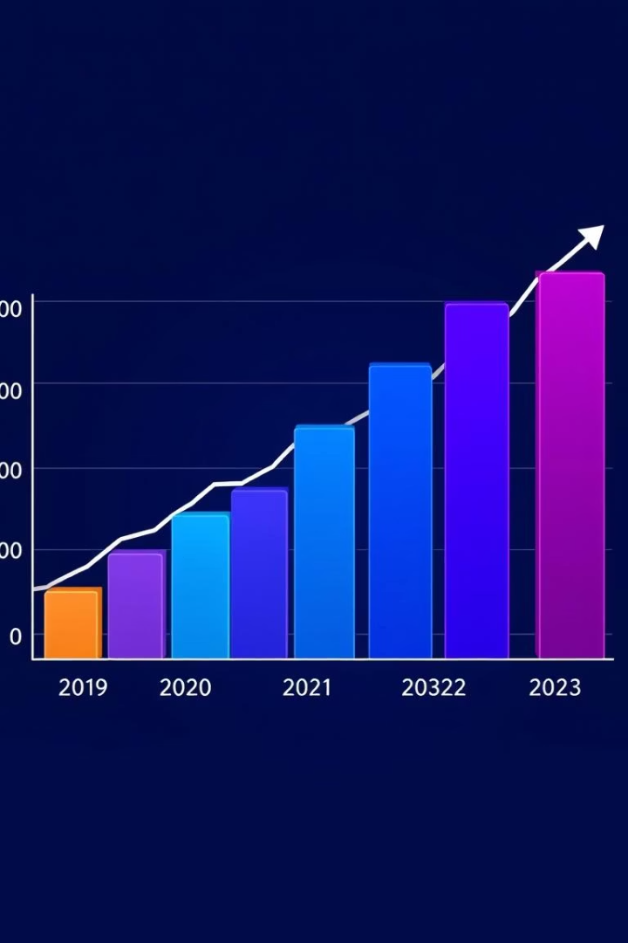
Financial Performance Overview
Total Revenue
Gross Profit Margin
Increased by \$[Amount], showing a [Percentage]% year-over-year growth.
Reached [Percentage]%, climbing [Percentage]% from FY21.
Net Income
Grew to \$[Amount], reflecting a [Percentage]% increase.
Key growth driven by [Specific products or services].

Slide 3




Sales and Marketing Success
Transactions
Average Value
Website Traffic
[Number] total, a [Percentage]% increase.
ATV reached \$[Amount], up [Percentage]%.
[Number] visits, [Percentage]% conversion.
[Campaign Name] achieved [Quantifiable Result].

Slide 4
Operational Enhancements
Inventory Turnover
Supply Chain
Customer Service
Increased to [Number] times.
Lead times cut by [Percentage]%.
Satisfaction scores improved by [Percentage]%.
[Specific Technology] yielded [Quantifiable Benefit].

Slide 5
Customer Loyalty and Insights
CSAT Score
1
[Score], a [Percentage]% improvement.
NPS Score
2
[Score], strong loyalty.
CAC
3
\$[Amount], decreased [Percentage]%.
Insights into demographics and behavior.

Slide 6



Employee Growth and Satisfaction
Turnover
2
[Percentage]%, below average.
Satisfaction
1
[Score], up [Percentage]%.
Training
3
Invested in [Specific Programs].
Effective recognition initiatives implemented.

Slide 7
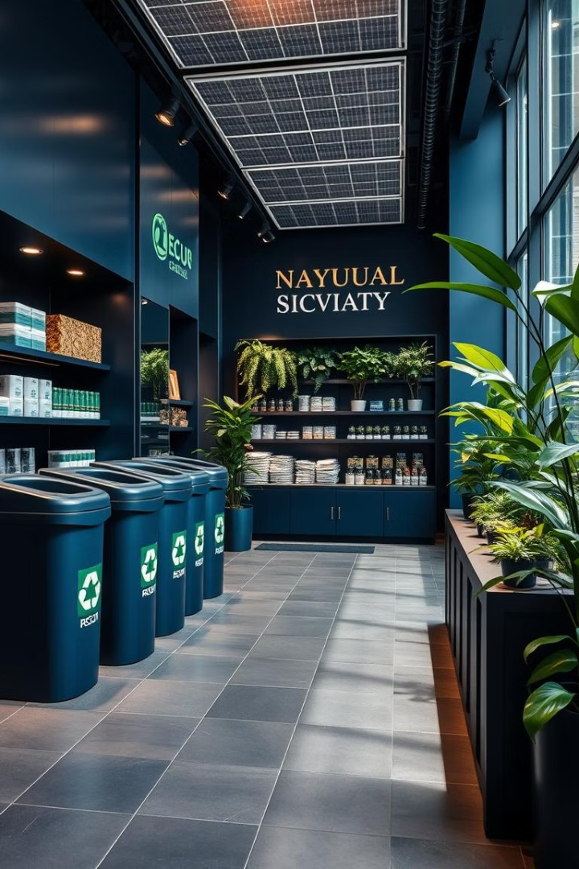



Sustainability Efforts and Impact
Carbon Footprint
Reduced by [Percentage]%.
Waste Reduction
[Quantifiable Results] achieved.
Ethical Sourcing
[Specific Examples] followed.
Engaged in community and philanthropic activities.

Slide 8



Future Strategy and Outlook
1
Growth
2
Expansion
3
Innovation
Projected revenue growth is [Percentage]%. Expansion plans include [Specific Locations or Markets]. Strategic priorities: [Priority 1], [Priority 2], [Priority 3]. Committed to continuous improvement.

